Slide 1

Hacking Cars
This presentation explores car vulnerabilities and how to exploit them. It covers essential security concepts like physical attacks, network intrusions, and data manipulation.
By: Dennis Freyman

Slide 2
Table of Contents
1
Capturing and Replaying the Keyless Entry Signal
2
Relay Attack on Passive Keyless Entry
3
CAN Bus Injection via OBD-II Port
4
4. Exploiting Vulnerabilities in Infotainment Systems

Slide 3

Section 1: Capturing/ Replaying the Entry Signal

Slide 4



Step 1: Capturing the Radio Frequency (RF) Signal from the Key Fob
Frequency
Interception
Software
Key fobs generally transmit radio signals at specific frequencies: 315 MHz in the US and 433.92 MHz in Europe.
To intercept this signal, you need a Software-Defined Radio (SDR) device, such as HackRF One or Flipper0, which can tune into (and then capture) the key fob's RF frequency.
Using software like GNU Radio or the flipper's built in software, you can capture the signal transmitted by the key fob when the owner locks or unlocks the car.

Slide 5


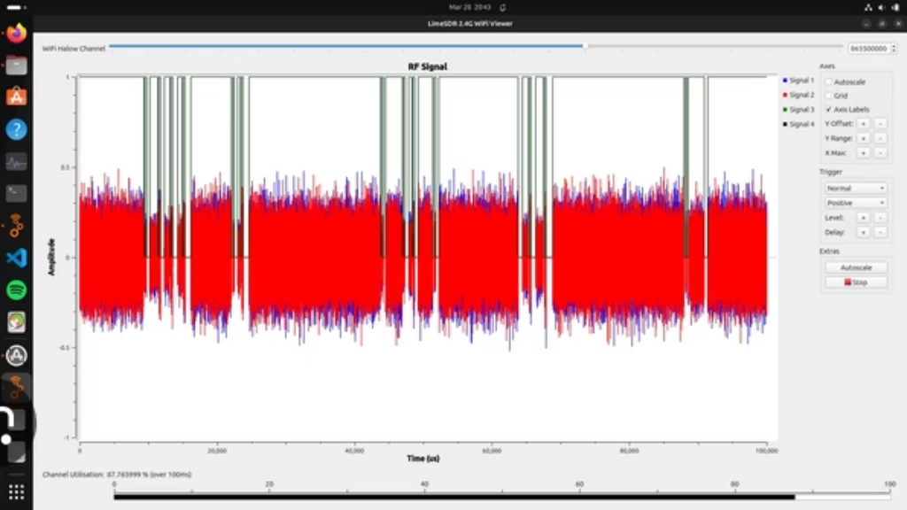
So…
Capture with tool
Use Software to Store signal
Find time when signal is sent
(Flipper Zero shown above)
(GNU Radio shown)
(315 Mhz in USA)

Slide 6



Step 2: Replaying the Captured Signal (Replay Attack)
Signal Reproduction
Further Vulnerability
Next Step
After capturing the RF signal, you can transmit it at the same frequency using the SDR device. The vehicle will recognize this signal as valid and unlock the doors.
Though this method will work on many older cars, most cars manufactured post 2013 will have a rolling code system. These will generate new keys every time for the keyfob, therefore breaking this method….but
Breaking rolling code systems is…possible too. But how?

Slide 7
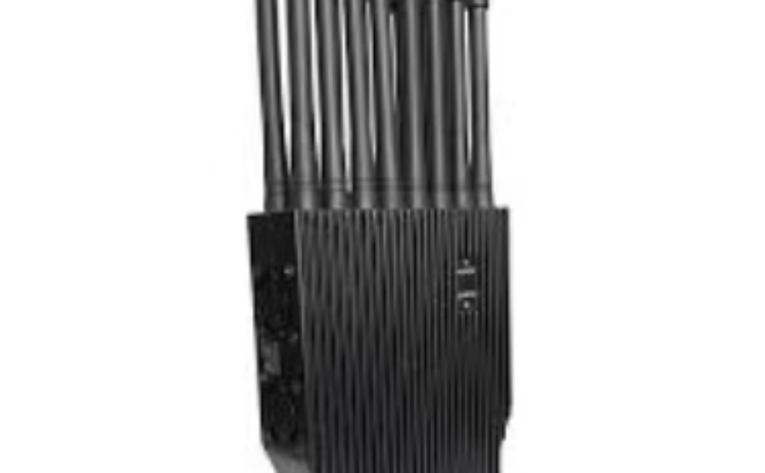
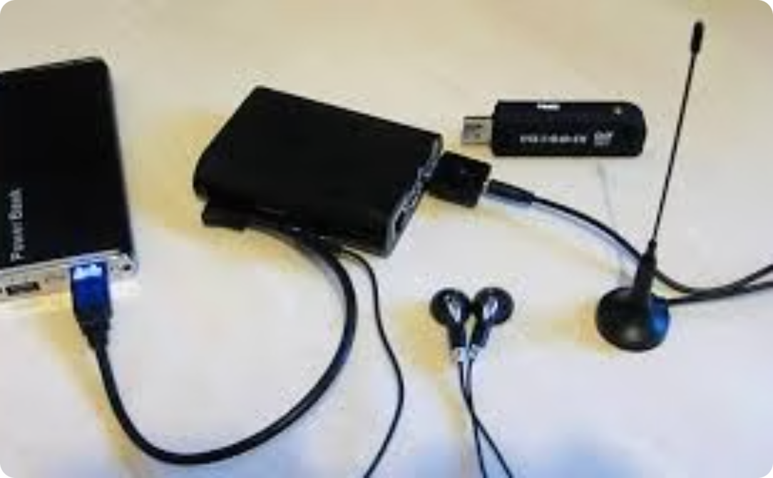
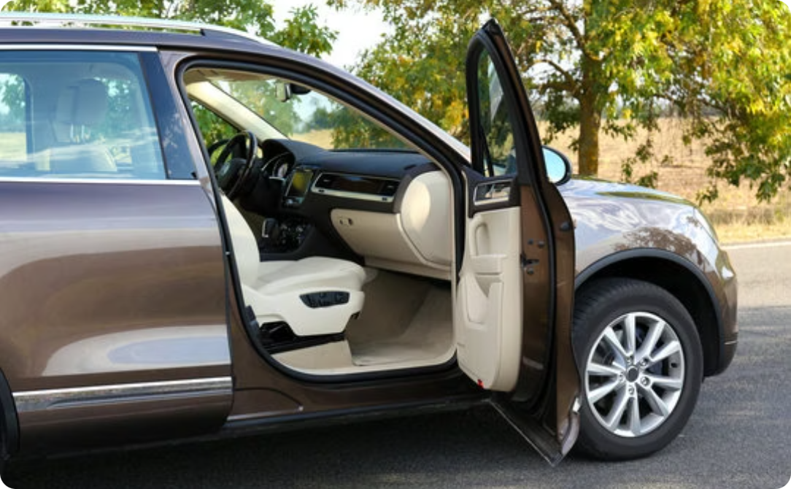
Bypassing Rolling Code Systems (Step 2.5)
Jamming
Capture
Execution:
The attacker could use a radio frequency jammer, or RF Jammer, such as a Jammer PRO16 to continuously transmit a signal at the key fob’s frequency, overwhelming the car’s receiver, and stopping all in/outbound connection.
While the car is unable to receive the signal, the attacker uses an SDR to capture the rolling code generated by the key fob (which isn't changing due to the car not receiving it).
Once the jamming stops, the attacker can transmit the captured rolling code to the car using the SDR at the correct frequency. The car interprets the replayed signal as legitimate because it never received the original signal and is waiting for this code.

Slide 8
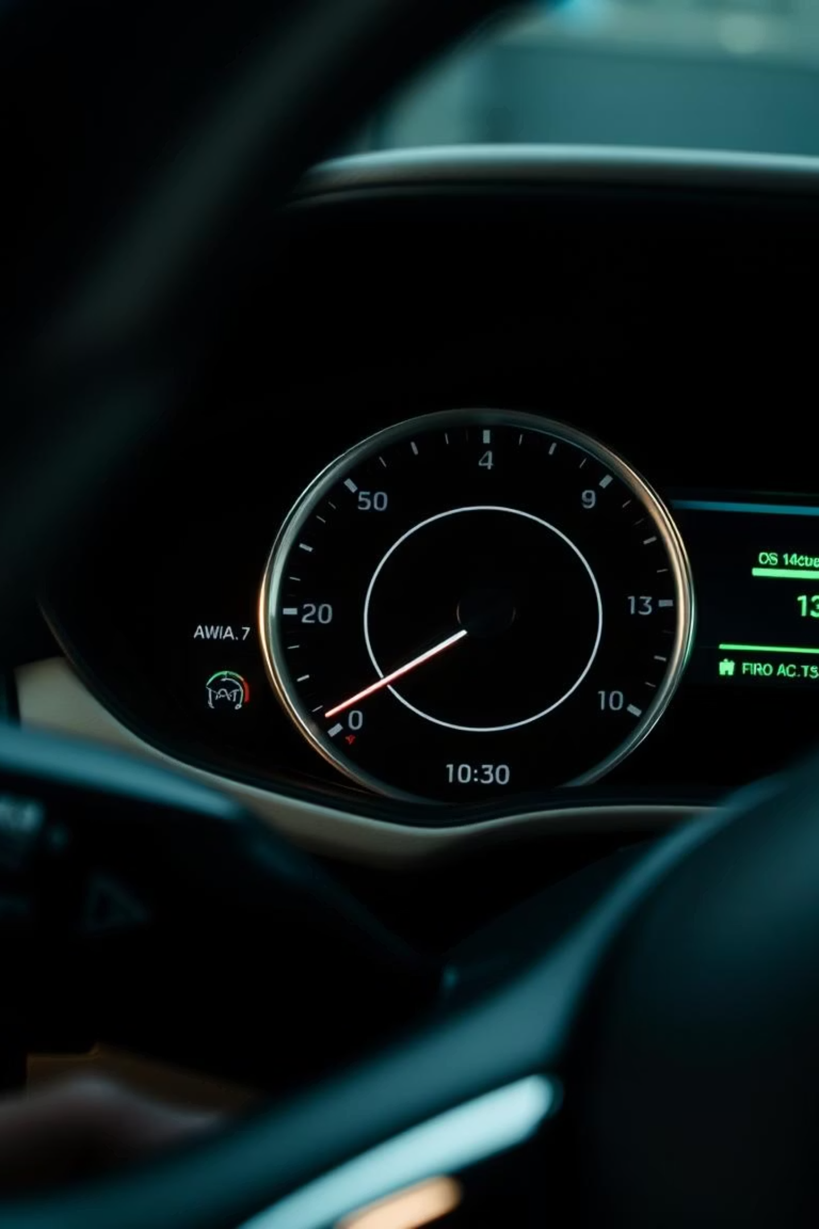
Section 2: Physical Compromise

Slide 9

Component 2: Manipulating the Onboard Computer
Disclaimer
This method requires physical access to the onboard computer, so you would first need to be in their car. (please dont use this on your friends)

Slide 10
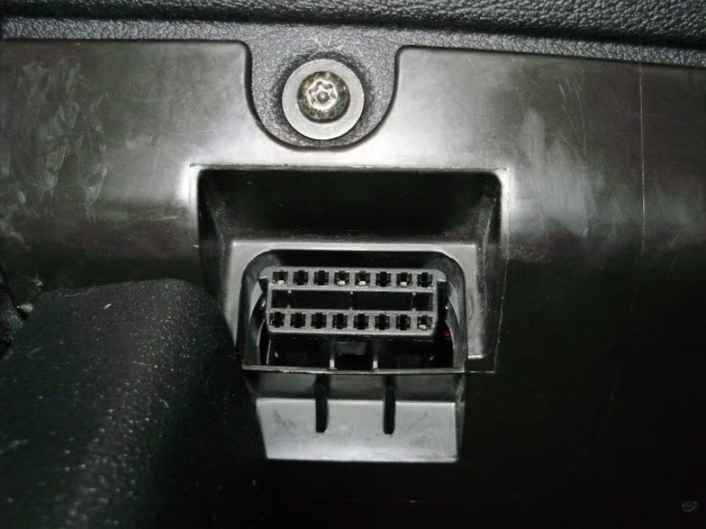
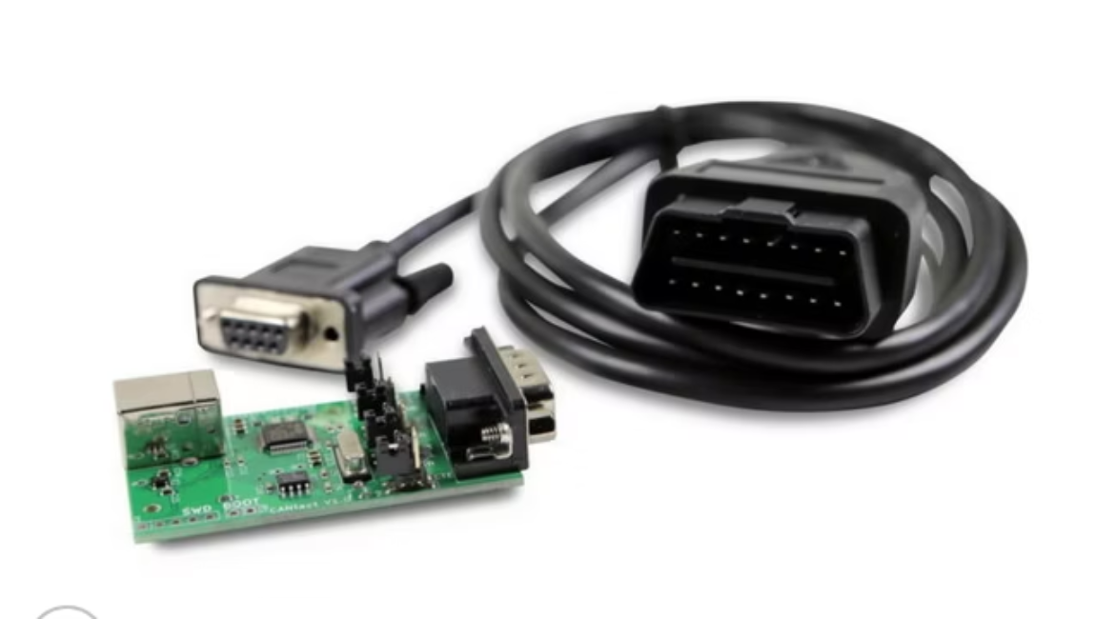
Step 2: You are now in the Car
CAN Bus Injection via OBD-II Port
Injecting into the CAN bus.
All modern vehicles, have an OBD-II port, usually under the dashboard. This port provides access to the car’s CAN bus (or Controller Area Network electronic pathway), which is responsible for communication between the car’s electronic control units (ECUs).
By connecting a device like a CANtact or USBtin, you can send commands over the CAN bus. The OBD-II port is designed to provide diagnostic access, but it can also be used to inject messages into the CAN bus, allowing access to things such as door locks, engine control, and even critical systems like brakes or steering.

Slide 11



Inject Commands into the CAN Bus
Software
Identify ECU IDs
Crafting and Injecting CAN Commands
Along with the physical device such as the CANtact, the intruder needs software capable of crafting custom CAN messages, such as SocketCAN, BusMaster, or SavvyCAN.
each ECU (e.g., the door lock system or engine control) on theCAN bus has a unique identifier called a CAN ID. The attacker needs to know the CAN ID for the specific ECU they wish to control. For instance, the ECU responsible for controlling door locks might have a CAN ID of 0x123.
A CAN command or frame has 2 parts: An identifier that specifies which ECU the message is intended for, and the data field. The identifier is the device that the intruder wants to attack, and the data field is the command, such as 0x01 in the data field to signify the "unlock" command for a door

Slide 12
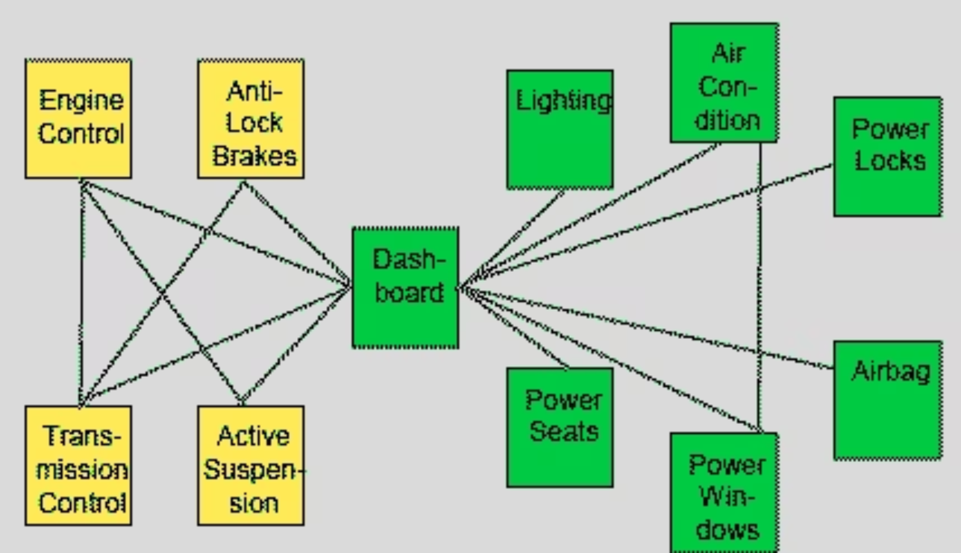
Why This Works:
The CAN bus does not inherently validate the source of a message. As long as the message is formatted correctly and the attacker knows the correct CAN ID and data field, the ECU will execute the command. This lack of authentication is a common vulnerability in many vehicles, very rarely patched.

Slide 13

Mitigation
Digital Signatures: Some very modern day vehicles require that CAN messages be digitally signed or authenticated. This ensures that only legitimate, authenticated commands from trusted sources are executed by the ECUs. Without the correct signature, injected commands would be ignored. However, these vulnerabilities are still very prevalent in most vehicles out on the street today.

Slide 14

Thank You!
Dont break your friends' cars please and thank you.

